Slide 1
Assignment #1 Zentangle
Finish the Zentangle from yesterday.
On the back create your own Zentangle design.Upload picture to your website (after you create the website tomorrow) and answer questions about your work.

Slide 2
Types of pencils
6B to 6H
What does B and H mean?

Slide 3
Assignment #2 Pre-instruction Drawings
1. Face (shoulders and up)
2. Hand
3. Pinecone

Slide 4
Contour Drawing
A contour is the line which defines a form or edge - an outline and major lines inside the figure.

Slide 5
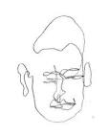
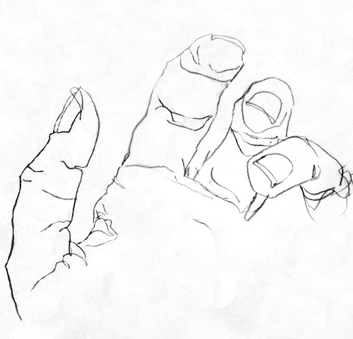
Blind Contour Drawing
Do not pick up your pencil or look at your paper.

Slide 6
Assignment #3:
Draw a blind contour drawing of your hand
Pair up and draw a blind contour drawing of your partners face

Slide 7
Modified Contour Drawings
Contour drawings – a line drawing where you may look at your paper (although you need to look at your subject the majority of time) and may pick up your pencil.
Pencil is going the same speed as your eye is looking at the object. The eye and hand must work together.
May vary the width of the of the line.

Slide 8
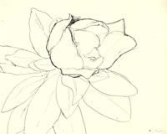
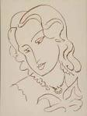
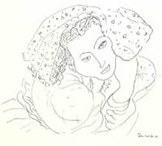
Contour drawings by Henri Matisse

Slide 9
Why are we doing these exercises?
To learn to really look at the subject!!!
To learn to see the edge and translate it into a smooth flowing line composition.

Slide 10
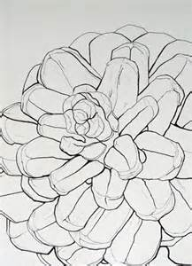
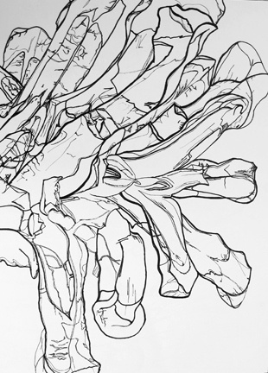
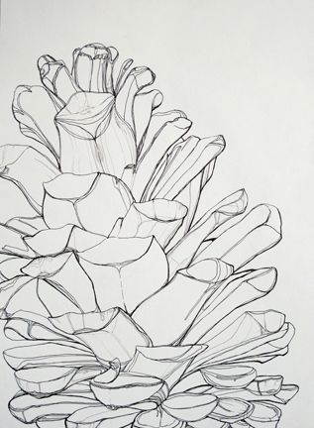

Slide 11
Assignment #4 Contour drawing of a pinecone
A. First draw a blind contour drawing of the pinecone to warm up (do this on copy paper).
B. In your sketchbook, complete a careful modified contour drawing of a pine cone. Draw quietly and continuously – working hard to shift to the right brain thinking mode. No sketching or shading. Show repetition of patterns and details. Look closely at the pinecone and draw only what you see using inner and outer contour lines.
Go slowly – draw what you see! Vary the width of the lines.

Slide 12
Video

Slide 13
Friday, January 23
Computer lab to work on website
You need to use an email address.
Weebly.com
Fill in information
Screen: Pricing Free
Screen: Choose a theme
Screen: Use a subdomain of Weebly.com
Use: EpiphanyFirstnameLastinitial@Weebly.com
Screen: Welcome
May either “Plan my site” or “Build my site”

Slide 14
What are the first 5 numbers of the Fibonacci Sequence? How did you find them?

Slide 15
Assignment #5 (Introduced on Friday) Elements of Art
The elements of art are: line, shape, form, color, value, texture, and space.
Write a poem, rap, or a silly sentence that will help you remember the elements of art. You may work alone, or in pairs, or in small groups of three. Be prepared to present to the class on Thursday.

